Slide 1
Pneumonia Detection via X-Ray Analysis using Deep Learning
B.Preetham

Slide 2
Introduction to Pneumonia and Deep Learning
1. What is Pneumonia?
Pneumonia is an infection that inflames the air sacs in one or both lungs, which can fill with fluid or pus, leading to symptoms such as cough, fever, chills, and difficulty breathing.
It is one of the top causes of death globally, especially among children and the elderly.
Early detection is crucial for better management and treatment.
2. Why X-Ray for Detection?
X-ray imaging provides a quick and non-invasive way to visualize the lungs, helping doctors spot signs of pneumonia like fluid in the lungs, lung consolidation, and abnormal patterns.
However, interpreting X-ray images manually can be time-consuming and prone to human error.

Slide 3
3. Role of Deep Learning in Pneumonia Detection
Deep learning, especially CNNs, has proven effective in automatically analyzing medical images with high accuracy.
The ability to identify patterns, even subtle ones, from X-ray images is why CNNs are ideal for this task.
4. Potential Impact:
Faster diagnosis and treatment.
Reducing human error in interpreting medical images.
Assisting healthcare workers, especially in resource-limited areas where radiologists are scarce.

Slide 4
Introduction to Image Recognition
Domain: Medical Imaging & Deep Learning Applications:
Automated diagnosis in radiology: AI systems can assist doctors in making faster, more accurate diagnoses by analyzing medical images such as chest X-rays.
Reducing manual workload for doctors: By automating parts of the diagnostic process, AI can help reduce the burden on radiologists, enabling them to focus on more complex cases.
Real-time diagnosis in rural areas: AI tools can be deployed in underserved regions, providing instant diagnosis where healthcare professionals are scarce.
Beyond Healthcare: Deep Learning models are also used in various other fields such as:
Object Detection
Face Recognition
Fraud Detection

Slide 5
Project Goal and Application
Project Goal :
The goal is to develop a deep learning model using CNNs and transfer learning to detect pneumonia from chest X-ray images. The model aims to automate diagnosis and improve accuracy, especially in differentiating bacterial and viral pneumonia.
Applications :
Medical Diagnostics: Assists healthcare professionals in diagnosing pneumonia more efficiently.
Telemedicine: Enables remote diagnosis, useful in rural or underserved areas.
Mobile Health: Integrates into mobile apps for early pneumonia detection.
Education: Aids in medical training and education on pneumonia detection.
Healthcare Analytics: Monitors and analyzes public health trends through X-ray data.

Slide 6
Literature Survey
Authors | Journal/Conference | Year | Title | Method | Merit | Demerit
Rajpurkar P., Irvin J., Zhu K. | IEEE Conference on Computer Vision | 2017 | CheXNet: Radiologist-Level Pneumonia Detection on Chest X-Rays with Deep Learning | CNN (Convolutional Neural Network) | Achieved radiologist-level performance | Requires a large dataset for training
Baltruschat I.M., Nickisch H., Grass M. | IEEE Transactions on Medical Imaging | 2019 | Comparison of Deep Learning Approaches for Multi-Label Chest X-Ray Classification | Multi-label classification | Handles multiple pathologies | Complex labeling and interpretation
Kermany D., Goldbaum M., Cai W. | Cell Press | 2018 | Identifying Medical Diagnoses and Treatable Diseases by Image-Based Deep Learning | Transfer learning using CNN | High accuracy in medical diagnostics | Generalization to new datasets limited
Wang X., Peng Y., Lu L. | IEEE Transactions on Medical Imaging | 2018 | ChestX-ray8: Hospital-Scale Chest X-ray Database and Benchmarks on Weakly-Supervised Classification | Weakly-supervised learning | Large dataset available for public use | Incomplete labeling
Zhang X., Zhang S., Liu S. | Bioinformatics and Biomedicine | 2020 | Pneumonia Detection on Chest X-rays using Deep Learning | ResNet-50 CNN | Improved classification accuracy | Needs fine-tuning for optimal results

Slide 7
Literature Survey
Lakhani P., Sundaram B. | Radiology: Artificial Intelligence | 2017 | Deep Learning at Chest Radiography: Automated Classification of Pulmonary Tuberculosis | Deep CNN | Automates TB detection | Limited to tuberculosis detection
Ouyang X., Huo J., Xi P. | Scientific Reports | 2021 | Pneumonia Detection in Chest X-ray Images using Generative Adversarial Networks | GAN-based model | Effective at generating new samples | Computationally expensive
Singh D., Kumar V., Kaur M. | Neural Computing and Applications | 2020 | Classification of COVID-19 Patients using CNNs and Chest X-ray Images | CNN | High performance in COVID-19 detection | May not generalize to pneumonia cases
Apostolopoulos I.D., Mpesiana T.A. | IEEE Access | 2020 | COVID-19: Automatic Detection from X-ray Images Utilizing Transfer Learning with Convolutional Neural Networks | Transfer learning | Efficient transfer learning model | Bias toward COVID-19 detection
Liang G., Zheng L. | Journal of Digital Imaging | 2020 | Combining Convolutional Neural Network Ensembles for Accurate Pneumonia Detection on Chest X-Rays | CNN ensemble | High accuracy with ensemble learning | Requires high computational resources

Slide 8
Problem Identification
Global Health Issue: Pneumonia is a leading cause of death worldwide, particularly affecting children and the elderly.
Human Error in Diagnosis: Manual X-ray analysis is prone to error, and skilled radiologists may not always be available.
Imbalanced Data: There are fewer pneumonia cases than healthy examples, creating challenges for accurate model training.
Pneumonia Variability: Different types of pneumonia (bacterial, viral) manifest in various ways, making detection difficult.
Data Access and Privacy: Limited availability of labeled medical data due to privacy concerns. ⁠

Slide 9
Objective
Develop two Pre-trained models which is already built for purposes like image recognition, the models are
VGG-16 (Visual Geometric Group)
Inception_V3
These models must be furtherly fine tuned with the training set to accustom them to recognise X-Ray images through its label
Further more, we would also like to train a Convolutional Neural Network (CNN) from scratch and differentiate both of them.

Slide 10
Abstract
Pneumonia remains a significant global health challenge, especially impacting vulnerable populations such as children and the elderly. Early diagnosis is crucial, yet manual interpretation of chest X-rays is time-consuming and prone to human error, particularly in resource-limited areas. This project aims to address these challenges by developing a deep learning model for automated pneumonia detection using Convolutional Neural Networks (CNNs).
The model was trained on a labeled dataset of X-ray images, using both pre-trained architectures (VGG-16, Inception-V3) and a custom CNN model. Data preprocessing techniques, including normalization and augmentation, were employed to improve model robustness and generalization. The VGG-16 model achieved promising accuracy metrics, making it suitable for deployment in real-time diagnostics.
The system was then deployed as a web application to enhance accessibility. A Flask-based backend was designed to process incoming X-ray images, while a frontend built with HTML, CSS, and JavaScript provides a user-friendly interface. This setup allows users to upload images and receive diagnostic feedback instantly, enabling the model’s application in telemedicine and mobile health solutions.

Slide 11
Existing Methodology
Manual Diagnosis by Radiologists:
Traditionally, pneumonia is detected through the manual interpretation of chest X-rays by radiologists, which is time-consuming and prone to human error.
Rule-Based Image Processing Techniques:
Initial attempts at automating pneumonia detection involved handcrafted features and rule-based algorithms such as edge detection, thresholding, and region-based segmentation.
Classical Machine Learning Approaches:
Earlier models used machine learning techniques like Support Vector Machines (SVMs) and Decision Trees, which required extensive manual feature extraction from X-ray images.
Deep Learning and CNN-Based Approaches:
Transfer Learning has become a standard approach where pre-trained CNN architectures (on large image datasets like ImageNet) are fine-tuned on medical datasets, reducing training time and improving accuracy.

Slide 12
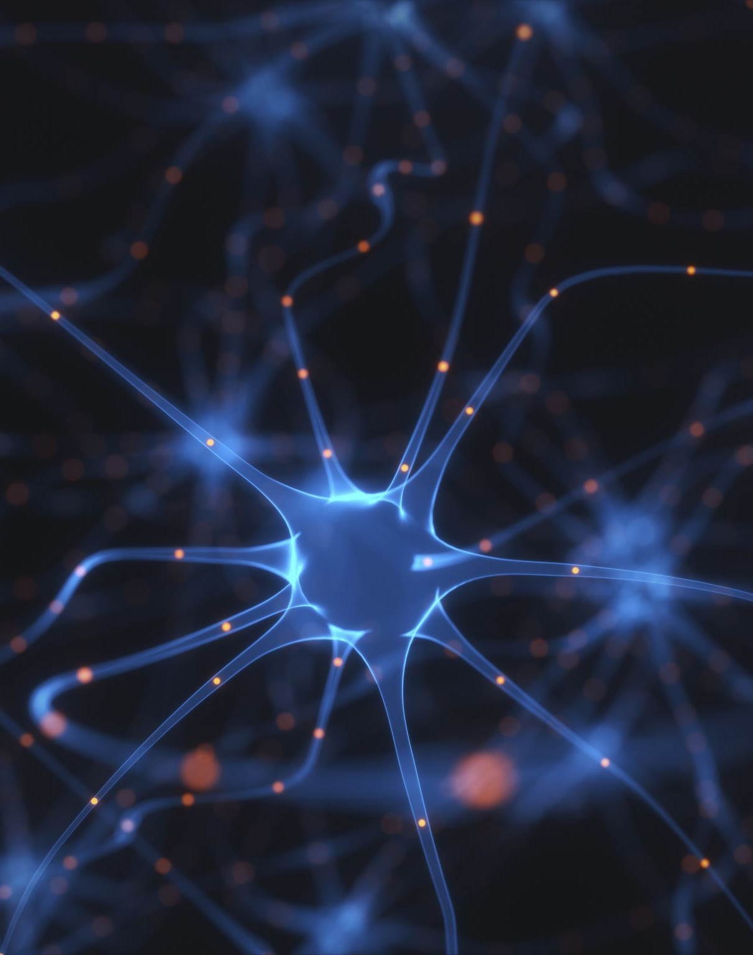
Deep Learning Fundamentals (CNN)
Convolutional Neural Networks (CNNs):
A type of deep learning model specifically designed to process image data.
CNNs consist of layers like convolution layers, pooling layers, fully connected layers, and activation functions.
How CNNs Work:
Convolution Layer: Extracts features from the input image
Pooling Layer: Reduces the spatial dimensions, making computations more efficient.
Fully Connected Layer: Combines all the features extracted and produces the final prediction
Activation Function: Usually, ReLU (Rectified Linear Unit) to introduce non-linearity, and Softmax for multi-class classification.

Slide 13
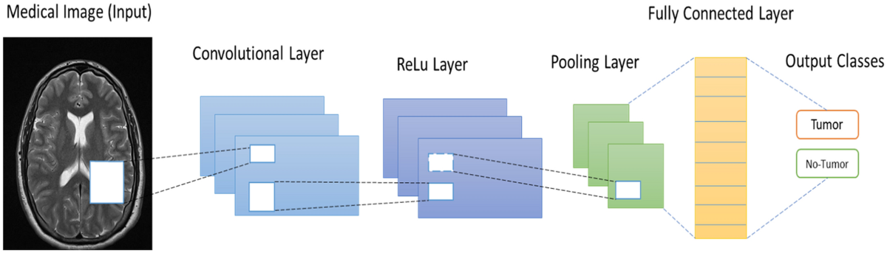
Advantages of CNNs in Medical Imaging:
Can automatically detect and learn complex features.
Eliminates the need for manual feature extraction.
Offers high accuracy in tasks like image classification.

Slide 14
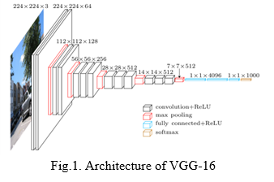
Proposed Methodology using CNN
Our approach involves developing an enhanced pneumonia detection system using a Convolutional Neural Network (CNN), specifically leveraging a VGG16-based architecture fine-tuned for medical image classification. Below is a detailed explanation of our methodology, from data pre-processing to model training and evaluation:
Dataset Preparation and Augmentation:
We used a publicly available dataset of chest X-ray images with labelled categories: "Pneumonia" and "No Pneumonia".
The dataset was split into training, validation, and test sets.
Image Augmentation techniques such as rotation, flipping, zooming, and brightness adjustment were applied to artificially increase the diversity of the dataset, reducing the risk of overfitting and making the model more generalizable to unseen data.

Slide 15

2. Model Architecture:
Multiple convolution layers with ReLU activation functions to capture image features.
Max-Pooling layers to reduce spatial dimensions and complexity.
Final layers include a Flatten layer followed by a fully connected dense layer with a softmax activation function for binary classification (Pneumonia/No Pneumonia).
3. Model Training:
The model is compiled with the Adam optimizer and binary cross-entropy loss function, suitable for binary classification problems.
Batch Size: A batch size of 32 is used, and the model is trained over 10 epochs.
Evaluation Metrics: During training, the model’s performance is monitored using accuracy, validation accuracy, and loss. These metrics help determine how well the model is learning and generalizing.
4. Evaluation:
After training, the model is evaluated on the test set using various metrics such as accuracy, precision, recall, and F1-score. A confusion matrix is generated to show how well the model distinguishes between pneumonia and non-pneumonia cases.

Slide 16
The model's predictions are compared to ground-truth labels to determine its effectiveness. An overall accuracy of 97% is achieved, with precision and recall for pneumonia detection also demonstrating the model’s reliability.
5. Results and Analysis:
The trained model demonstrates strong performance, with an accuracy of around 97% on the validation and test sets.
Data Collection
Data preprocessing
Model Training
Model Evaluation
Testing on unseen data
Performance Analysis
Analysis Visualisation

Slide 17
Algorithm steps
Import Modules
Load Data and Pre-process
Train Test Split
Visualize data
Train CNN with pre-trained layers frozen
Fine-tune and validate.
Evaluate using metrics and confusion matrix.
End

Slide 18
Model Architecture and Design
VGG16 Architecture:
A pre-trained model on ImageNet, fine-tuned to classify pneumonia images.
Composed of 16 layers, VGG16 captures a variety of complex features from the images.
InceptionV3 Architecture:
Another popular pre-trained model used for transfer learning, offering a deeper architecture that uses multiple filter sizes in parallel.
Custom CNN:
Designed specifically for pneumonia detection, the custom CNN could have convolutional layers tailored to focus on pneumonia-related features in X-rays.

Slide 19
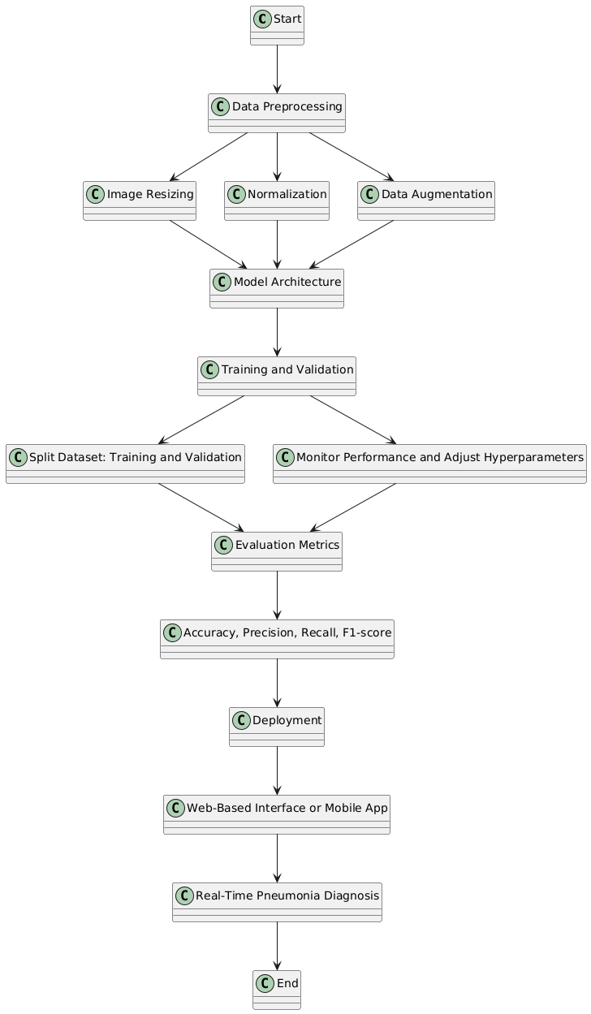
Block Diagram :

Slide 20
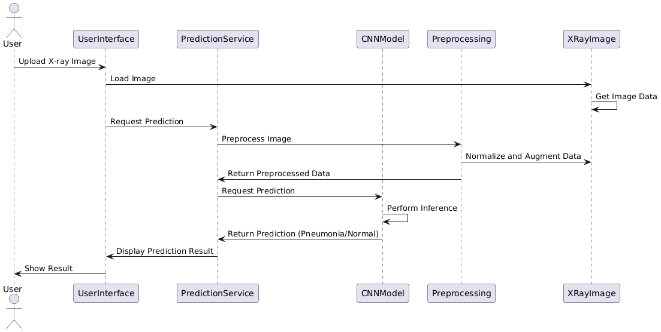
Sequence Diagram

Slide 21
Tools Used
Libraries:
Path and Directories handling libraries (os and glob)
Python (TensorFlow, Keras)
Scikit-learnImbalanced-learn (for RUS)
Seaborn
Matplotlib (for visualization)
ImageDataGenerator: Used for augmenting images, which helps increase the dataset's diversity during training.
Pre-trained Models: VGG16, InceptionV3
RandomUnderSampler from imblearn for class balancing.
Callbacks for model optimization: EarlyStopping, ReduceLROnPlateau, ModelCheckpoint

Slide 22
Datasets for Pneumonia Detection
Dataset Source: The dataset used for training the model is typically a collection of chest X-ray images with labels indicating pneumonia and non-pneumonia cases.
Challenges:
Data Imbalance: Often, there are far fewer images of pneumonia than healthy lungs, which can bias the model towards predicting the majority class.
Quality of Images: Variations in image quality, resolution, and patient demographics can affect model performance.

Slide 23
Preprocessing Techniques:
Normalization: Scaling pixel values to a standard range (e.g., 0-1).
Augmentation: To overcome data imbalance, techniques like rotation, flipping, and zooming are used to artificially increase the number of training images.
Resizing: Images are resized to a standard size (e.g., 224x224 for VGG16).
Data Split:
Training Set: Typically 80% of the data used to train the model.
Validation Set: 10% used to validate the model during training to tune hyperparameters.
Test Set: 10% used to evaluate the final model.

Slide 24
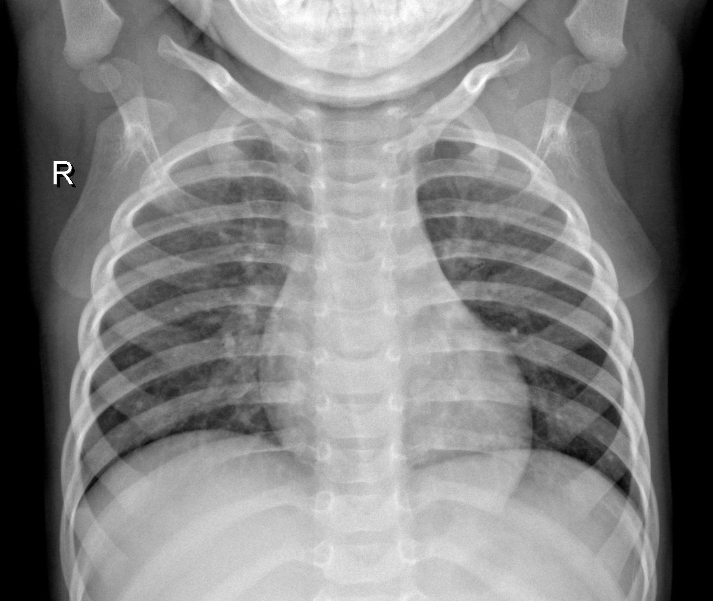
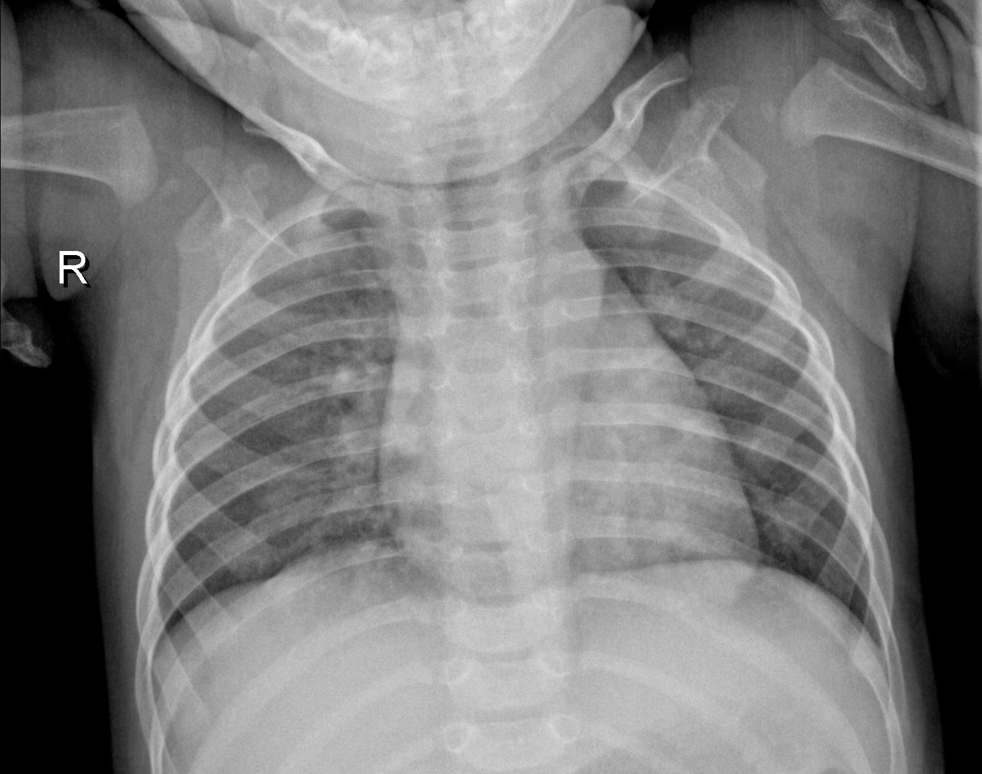
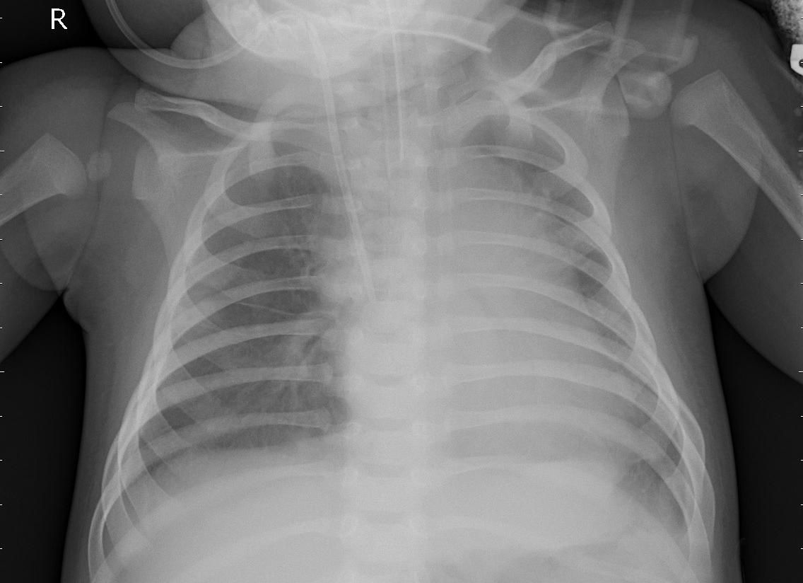
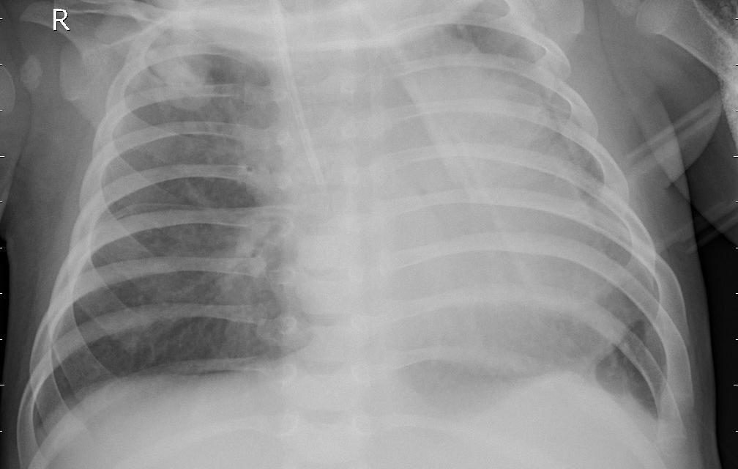
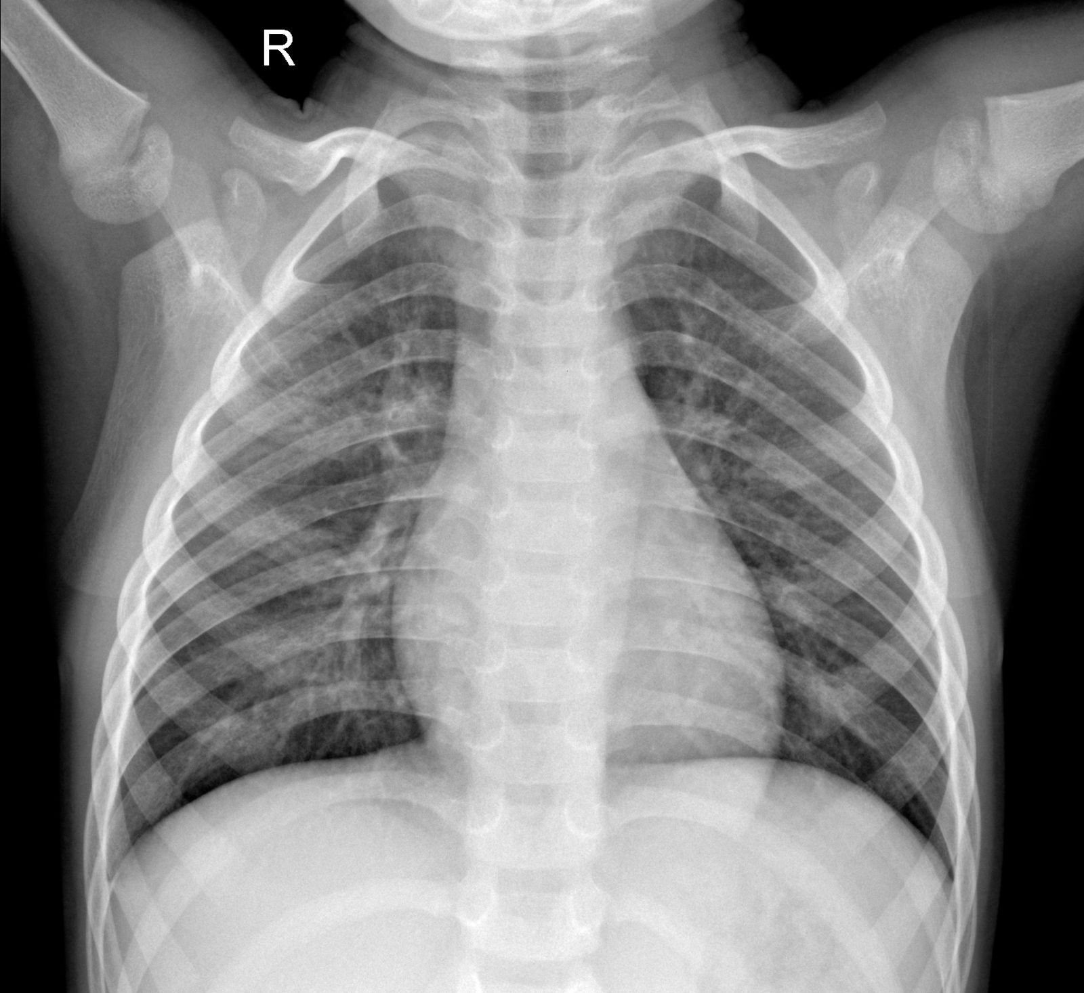
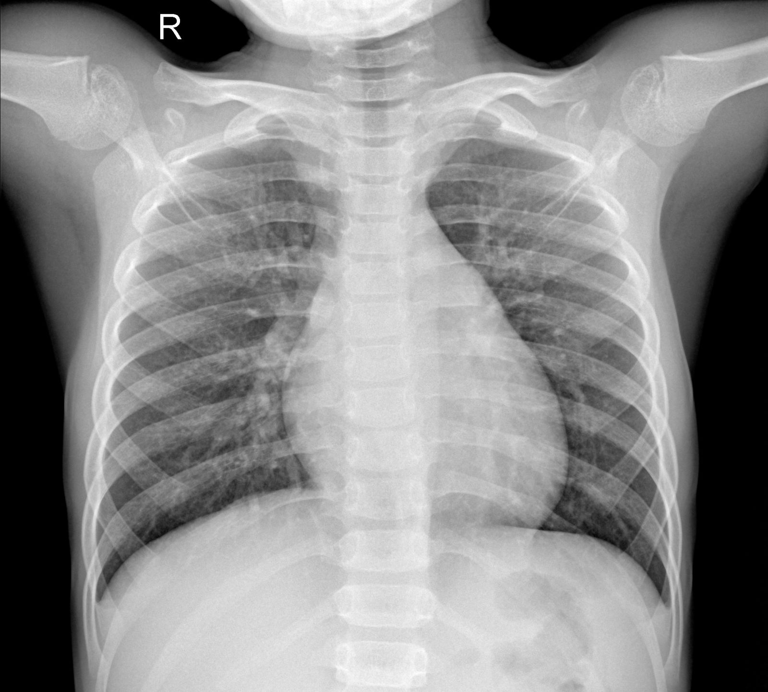
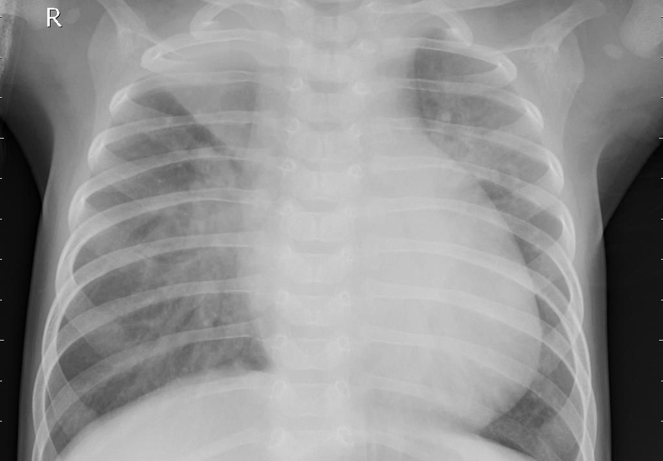
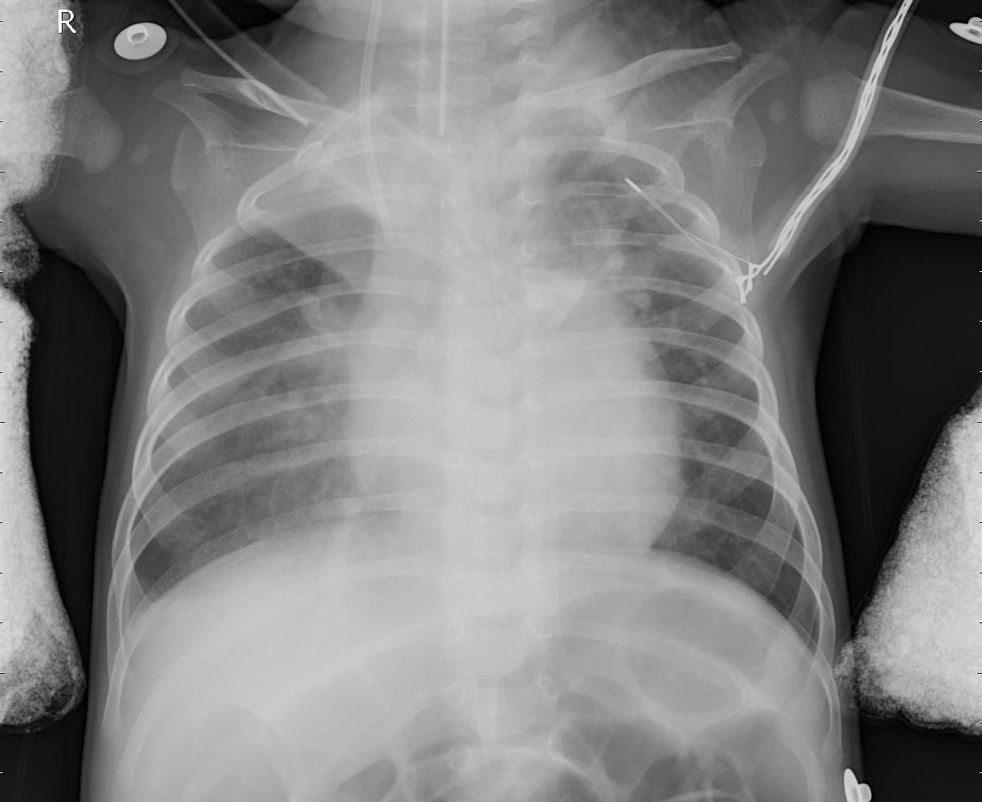
Sample Dataset Images
No Pneumonia
Pneumonia

Slide 25
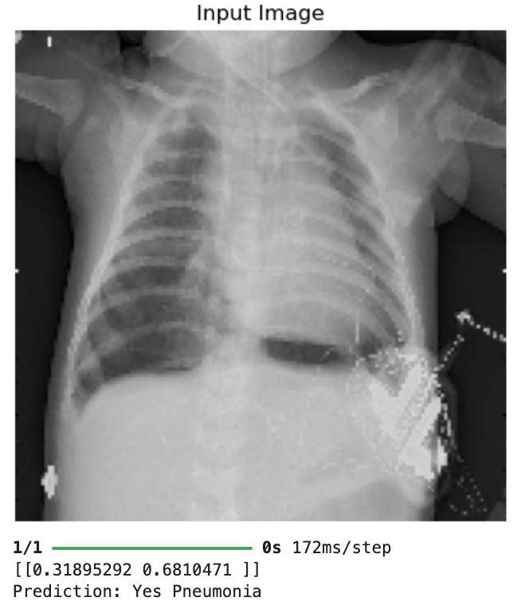
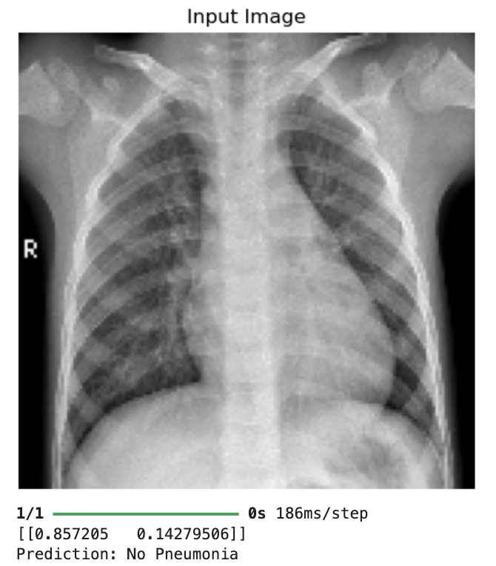
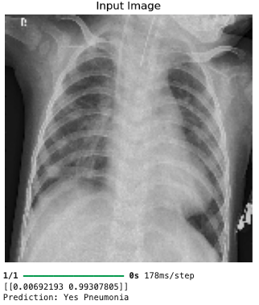
Input with Output
Output – Correct
Output – Correct
Output – Correct

Slide 26
Training the Model
Training Process:
Loss Function: Binary Cross-Entropy for classification into two classes (Pneumonia vs. No Pneumonia).
Optimizer: Adam Optimizer, commonly used due to its efficiency and faster convergence.
Epochs and Batch Size: The model is trained over multiple epochs (e.g., 10-20) with batch sizes of 30 or 64.
Model Evaluation:
Accuracy: 97%
Precision: 95%
Recall: 98%

Slide 27
Workflow
Review 0:
Initial Project Setup and Planning
Problem Identification:
Recognized pneumonia as a leading global health concern, especially impactful on vulnerable populations (children, elderly).
Identified limitations of traditional X-ray interpretation—time-consuming and prone to human error.
Highlighted the potential of deep learning to provide consistent, accurate diagnosis support.
Literature Review:
Reviewed prior research on pneumonia detection through machine learning, classical methods, and deep learning.
Analyzed existing CNN architectures, VGG-16 and Inception-V3, noting their prior applications and strengths for medical imaging.
Identified challenges, including data privacy and the need for high-quality, labeled datasets.

Slide 28
Review 1:
Data Collection, Preprocessing, and Augmentation
Dataset Retrieval:
Acquired a labeled chest X-ray dataset for “Pneumonia” vs. “No Pneumonia” classification.
Ensured ethical data use, verifying privacy and data source integrity.
Data Pre-processing and Augmentation:
Standardized image size, normalized pixel values for model readiness.
Applied augmentation techniques (rotation, flipping, brightness) to expand data variability and minimize overfitting.
Addressed dataset class imbalance with additional augmentation and balancing techniques.
Data Visualization:
Visualized samples from each class to understand data structure.
Plotted augmentation impact to ensure diverse, balanced input for training.

Slide 29
Review 2:
Training and Evaluation of Pre-trained Models
Pre-trained Models (VGG-16 & Inception-V3):
Implemented VGG-16 with transfer learning, modifying layers for X-ray classification.
Fine-tuned specific layers to adapt to pneumonia detection.
Training and Initial Evaluation:
Trained VGG-16 on augmented data, monitored accuracy, precision, and recall.
Initiated Inception-V3 training to compare effectiveness with VGG-16, adjusting hyperparameters for optimized results.
Preliminary Results:
Generated confusion matrices for VGG-16 to assess prediction accuracy.
Evaluated early performance metrics, noting model strengths and limitations in recall and precision.

Slide 30
Review 3:
Comprehensive Training and Model Comparison
Final Inception-V3 Training:
Completed Inception-V3 training, noting improvements over VGG-16 in classification accuracy.
Compared metrics for precision, recall, and computation between VGG-16 and Inception-V3.
Custom CNN Development:
Built a custom CNN to tailor architecture specifically for pneumonia detection.
Observed model's learning curve, with metrics comparable to pre-trained models.
Future Model Enhancement:
Analyzed performance differences, considering ensemble methods and additional fine-tuning.
Planned next steps: testing models like ResNet50, and exploring ensemble models for boosted accuracy.
Developed a FrontEnd and Backend for X-ray analysis.

Slide 31
Deployment Overview
Objective:
To make the pneumonia detection model accessible as a web application for easy interaction and use.
Enable users to upload X-ray images and receive predictions on pneumonia presence in real-time.
1.Frontend Development.
2.Backend Development.

Slide 32
Backend Development with Flask
Framework Selection:
Flask was chosen due to its lightweight nature, making it suitable for deploying machine learning models as APIs.
Allows seamless integration with Python, ensuring compatibility with the model and libraries used.
Backend Functionality:
Established an API endpoint to receive image files from the frontend.
Processed image inputs, performed necessary pre-processing, and fed them into the trained model.
Returned prediction results as a response, classifying images as either “Pneumonia” or “No Pneumonia.”
Error Handling and Optimization:
Implemented error handling to manage incorrect file formats and missing inputs.
Optimized response times to ensure a smooth user experience even with larger image files.

Slide 33
Frontend Development with HTML, CSS, and JavaScript
Interface Design:
Created a user-friendly layout with HTML and CSS for an intuitive experience.
Designed upload buttons, result display areas, and instructions to guide users through the process.
User Interaction:
JavaScript handles interactions, such as image uploading and displaying feedback.
Ensured smooth asynchronous communication with the backend using AJAX, so users experience fast responses without page reloads.
Result Display:
Predicted results are displayed immediately on the page, allowing users to see “Pneumonia” or “No Pneumonia” predictions and associated confidence scores.

Slide 34
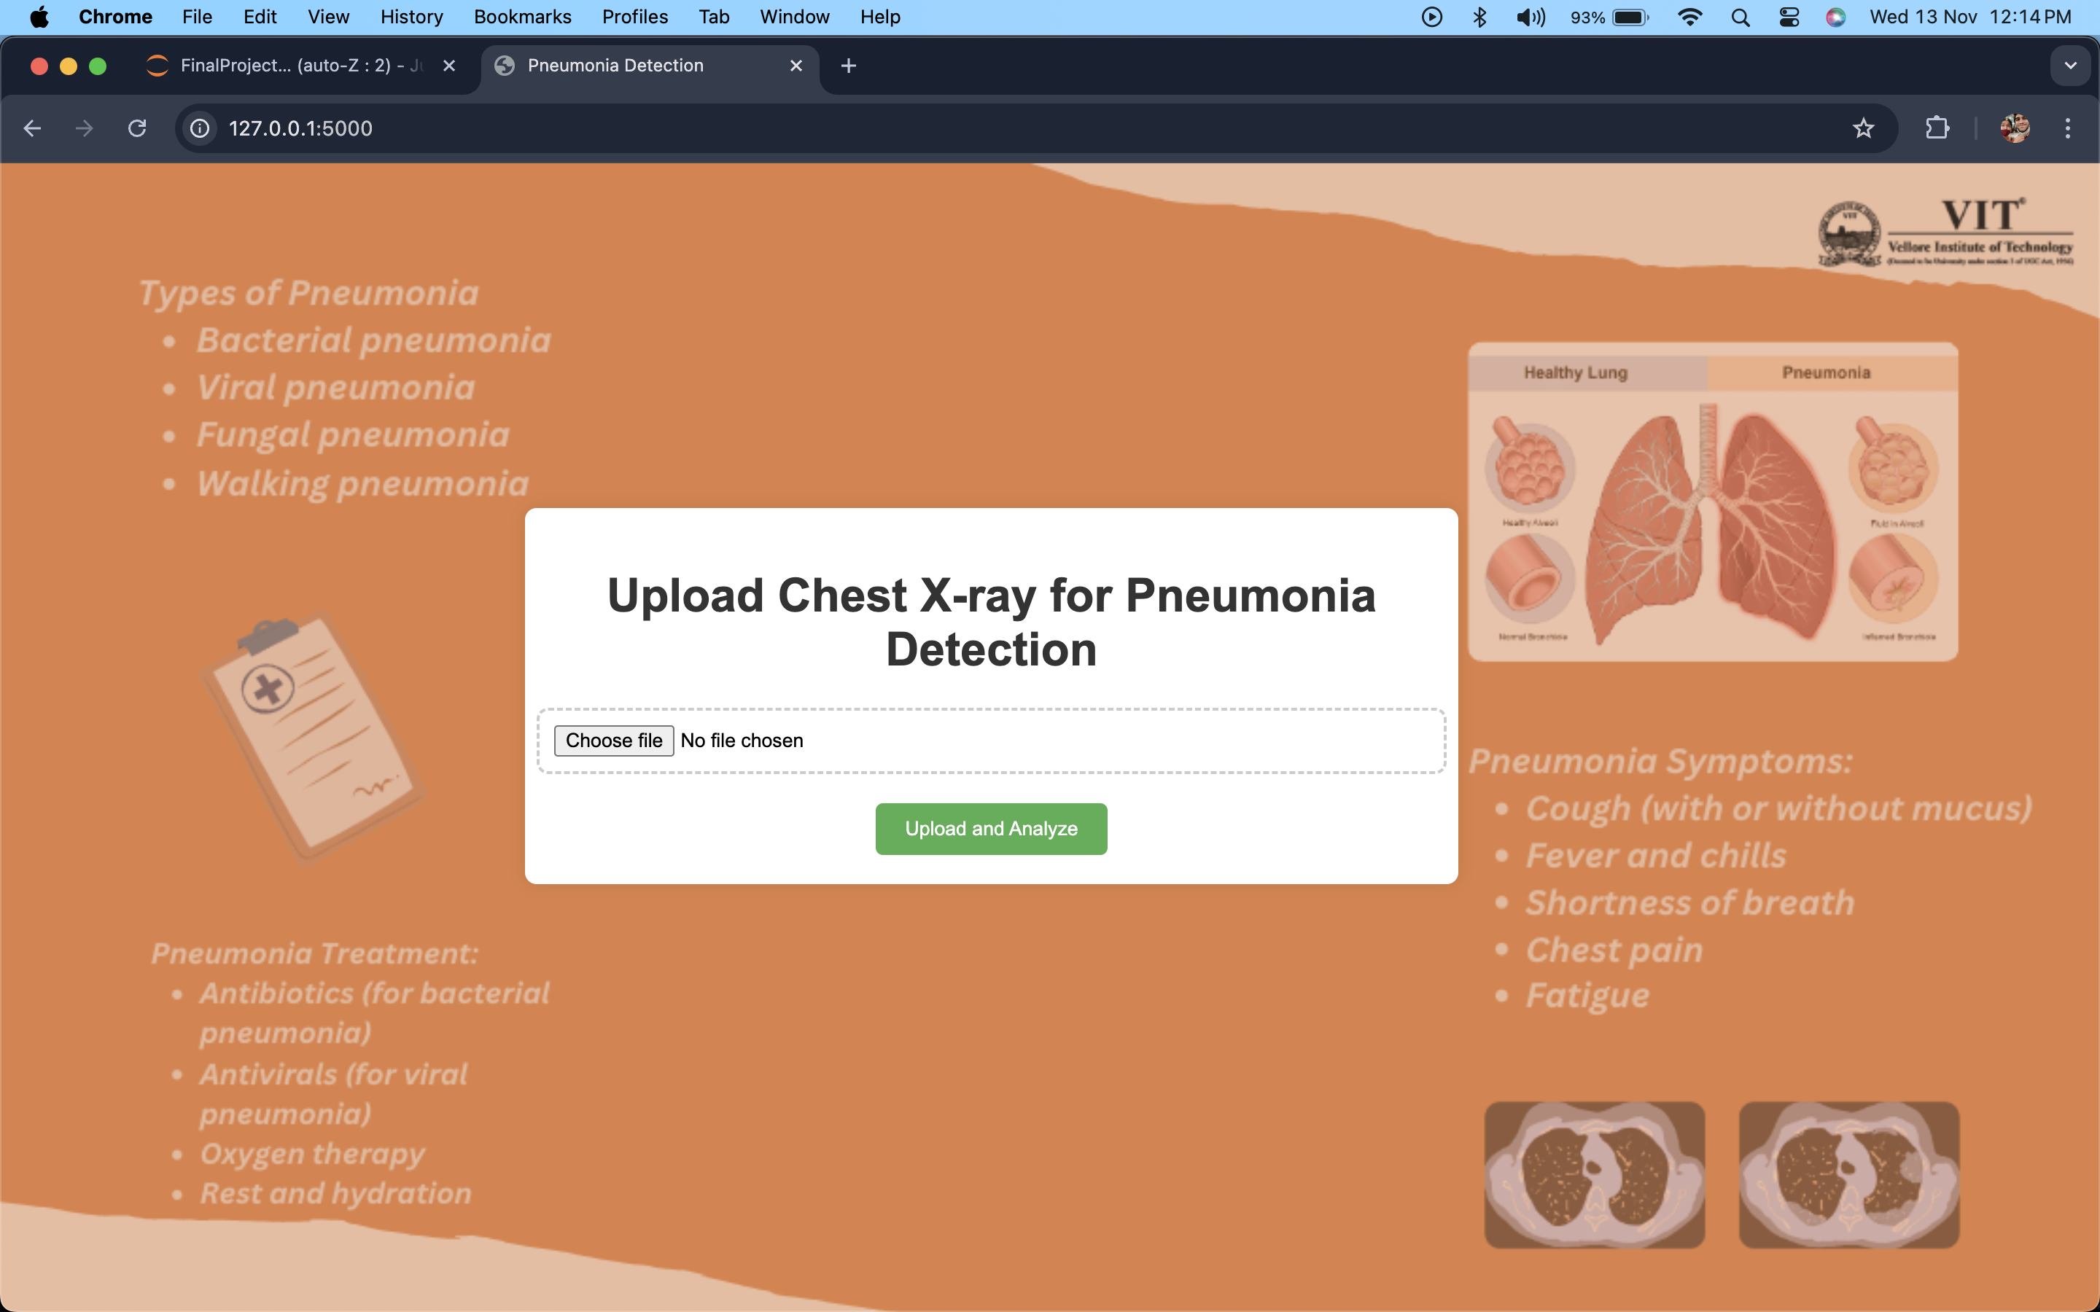
User Interface

Slide 35
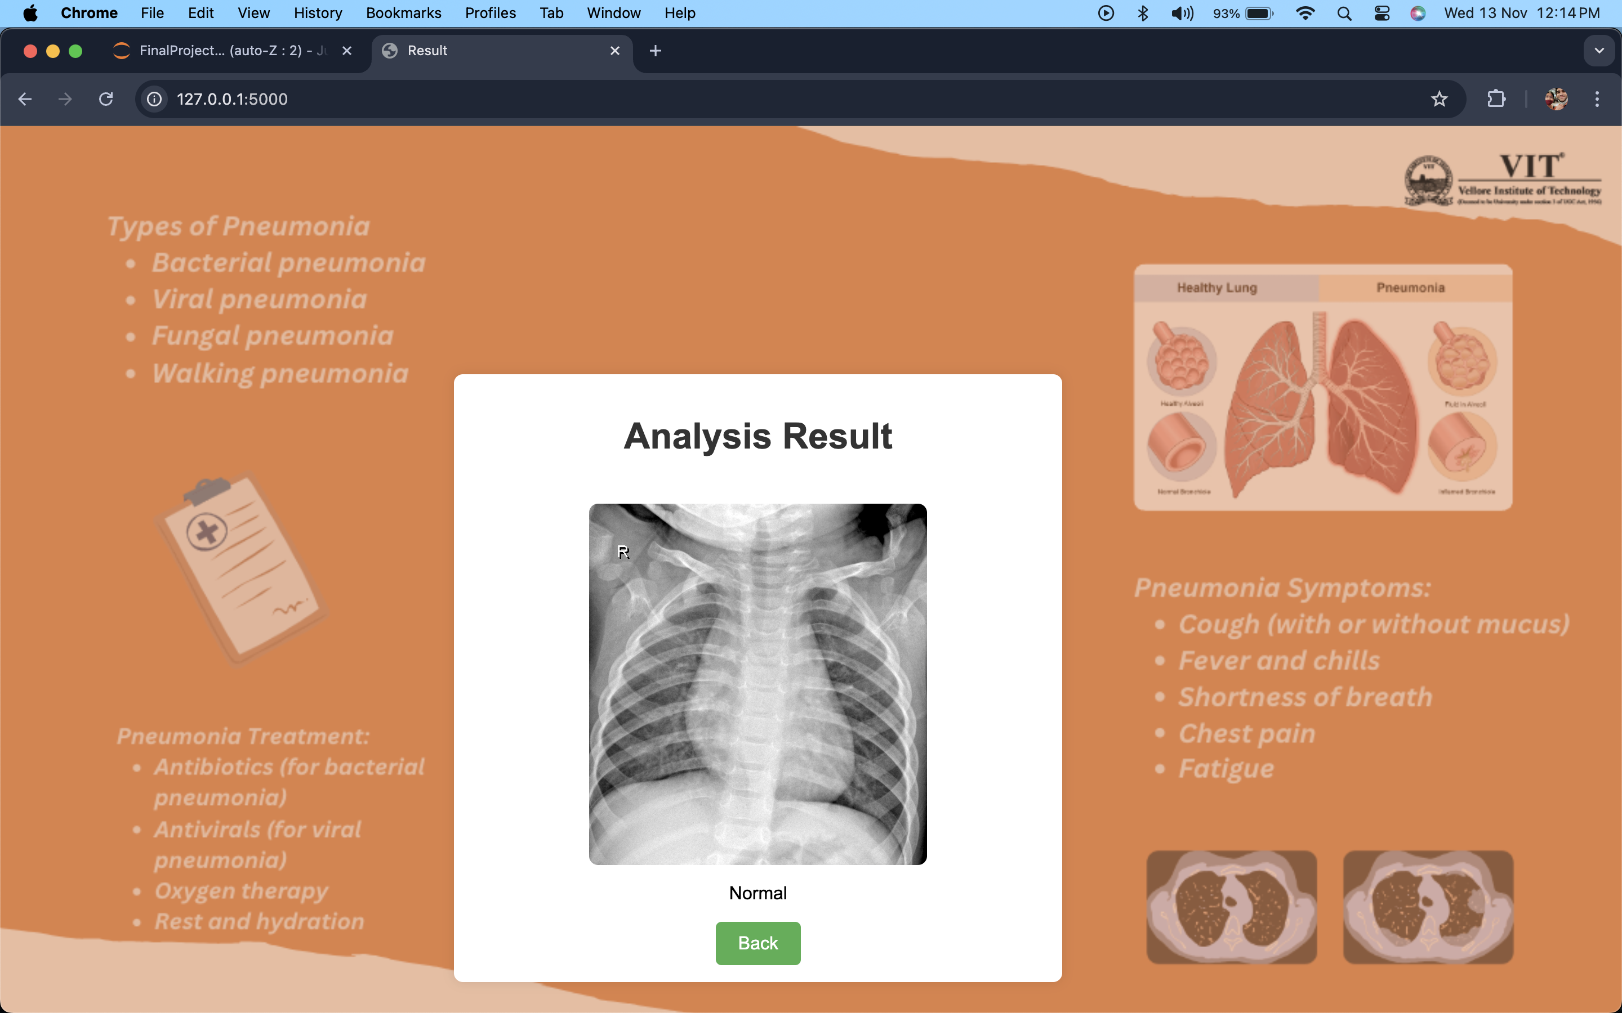
Output Interface

Slide 36
WorkFlow
Review 0:
Problem identification
literature review.
Review 1:
Dataset retrieval
Data pre-processing and augmentation
Data visualisation
Review 2:
Pre-trained model training and evaluation results.
Trained VGG-16 successfully and tried to train Inception-V3.
Review 3:
Will train Inception-V3 successfully
Train my own Convolutional Neural Network and evaluate the differences
Analyse how to further improve my model compared to the VGG-16 and Inception-V3

Slide 37
Progress
Work Done:
Data Augmentation
Data pre-processing and data acquirement
Model Architecture:
Imported VGG-16 and Inception-V3
The model was trained using the Adam optimizer
Improved accuracy of the model from 66% to 97% due to more data and dynamic learning rate
Made Frontend, Backend, Flask file to run the website as a local host
Hard coded a website which is ready to get hosted

Slide 38
Performance Comparison of CNN and VGG-16 model
Aspect | CNN model (Review 2) | CNNVGG-16 model (Review 3)
Model Architecture | Simple CNN | VGG16-based CNN
Feature Extraction | Basic convolutional layers | Pretrained VGG16 layers for feature-rich extraction
Training Time | Shorter, due to fewer layers | Longer due to deeper architecture
Accuracy | Moderate | Higher (improved pneumonia classification)
Generalization | Limited; may overfit smaller datasets | Better; VGG16 generalizes well on diverse datasets
Precision | Lower, prone to false positives | Higher, fewer false positives
Recall | Moderate, may miss subtle cases | Higher, more effective in detecting pneumonia cases
Data Requirements | Moderate data size | Works best with larger datasets due to VGG’s depth
Transfer Learning | Not used | Leveraged VGG16 pretrained weights

Slide 39
References
M. Dcunha, N. Naik, I. Francis and S. Mulla, "Pneumonia Detection in X-rays Using OpenCV and Deep Learning," 2021 International Conference on Communication information and Computing Technology (ICCICT), Mumbai, India, 2021, pp. 1-6, doi: 10.1109/ICCICT50803.2021.9510180.
Meepaganithage and M. Fernando, "Detecting COVID-19 Pneumonia using Chest X-rays through Deep Learning Techniques," 2022 2nd International Conference on Advanced Research in Computing (ICARC), Belihuloya, Sri Lanka, 2022, pp. 19-24, doi: 10.1109/ICARC54489.2022.9753784.
R. E. Al Mamlook, S. Chen and H. F. Bzizi, "Investigation of the performance of Machine Learning Classifiers for Pneumonia Detection in Chest X-ray Images," 2020 IEEE International Conference on Electro Information Technology (EIT), Chicago, IL, USA, 2020, pp. 098-104, doi: 10.1109/EIT48999.2020.9208232
Ayinam, G. S. Sai Sri Ram, G. Bhavana, G. Mikihil, A. Gurram and S. Madhavi, "Detection of Pneumonia and Tuberculosis using Deep Learning approach," 2023 8th International Conference on Communication and Electronics Systems (ICCES), Coimbatore, India, 2023, pp. 1141-1146, doi: 10.1109/ICCES57224.2023.10192888.

Slide 40
H.S, P. K.R, S. G, P. Rao and T. S.K, "Detection of Chronic Lung Disorders using Deep Learning," 2022 Fourth International Conference on Cognitive Computing and Information Processing (CCIP), Bengaluru, India, 2022, pp. 1-5, doi: 10.1109/CCIP57447.2022.10058633.
D. Varshni, K. Thakral, L. Agarwal, R. Nijhawan and A. Mittal, "Pneumonia Detection Using CNN based Feature Extraction," 2019 IEEE International Conference on Electrical, Computer and Communication Technologies (ICECCT), Coimbatore, India, 2019, pp. 1-7, doi: 10.1109/ICECCT.2019.8869364.
S. Singh, "Pneumonia Detection using Deep Learning," 2021 4th Biennial International Conference on Nascent Technologies in Engineering (ICNTE), NaviMumbai, India, 2021, pp. 1-6, doi: 10.1109/ICNTE51185.2021.9487731.
S. Shah, H. Mehta and P. Sonawane, "Pneumonia Detection Using Convolutional Neural Networks," 2020 Third International Conference on Smart Systems and Inventive Technology (ICSSIT), Tirunelveli, India, 2020, pp. 933-939, doi: 10.1109/ICSSIT48917.2020.9214289.

